Slide 1
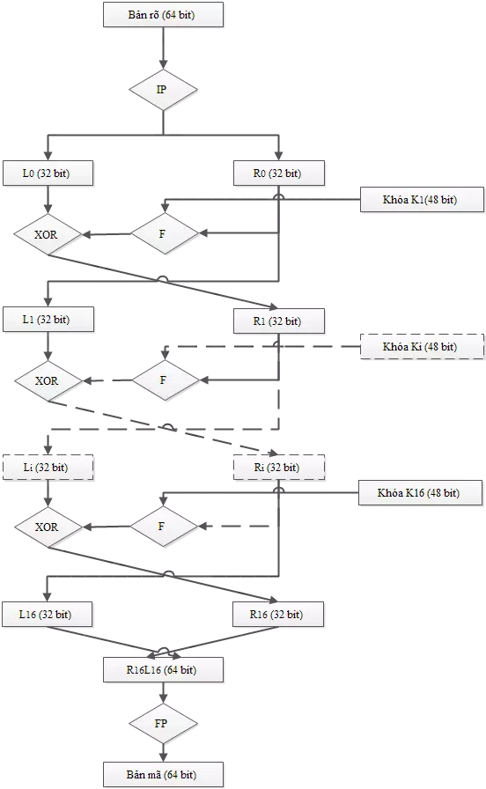
Plaintext (64 bit)
Key K1 (48 bit)
Key Ki (48 bit)
Key K16 (48 bit)
Ciphertext (64 bit)

Slide 2
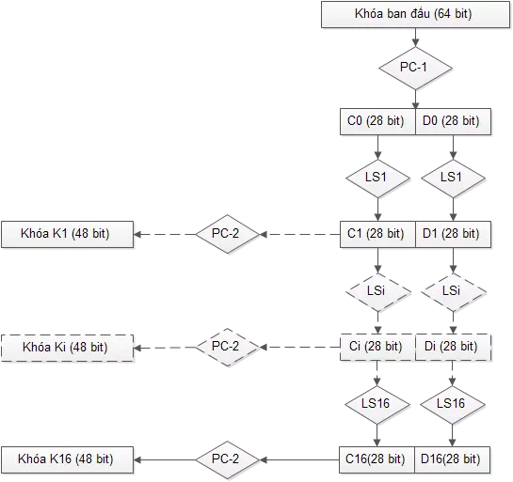
Initial key (64 bit)
Key K1 (48 bit)
Key Ki (48 bit)
Key K16 (48 bit)
Ciphertext (64 bit)

Slide 3
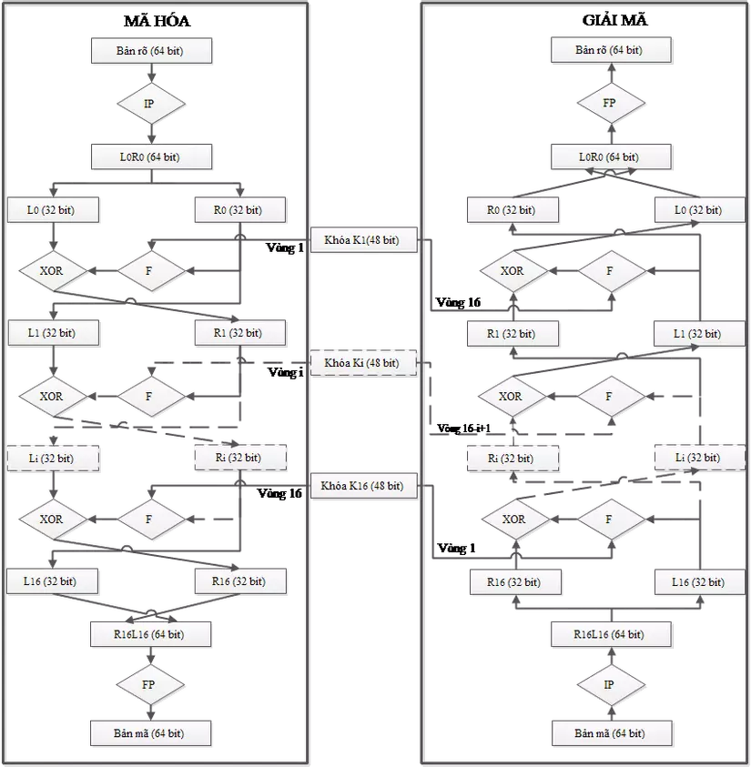
Encryption
Decryption
Plaintext (64 bit)
Plaintext (64 bit)
Initial key (64 bit)
Key K1 (48 bit)
Round 1
Key Ki (48 bit)
Round 16
Key Ki (48 bit)
Round i
Round 16-i+1
Key K16(48 bit)
Round 16
Key K16 (48 bit)
Round 1
Ciphertext (64 bit)
Ciphertext (64 bit)
Ciphertext (64 bit)

Slide 4
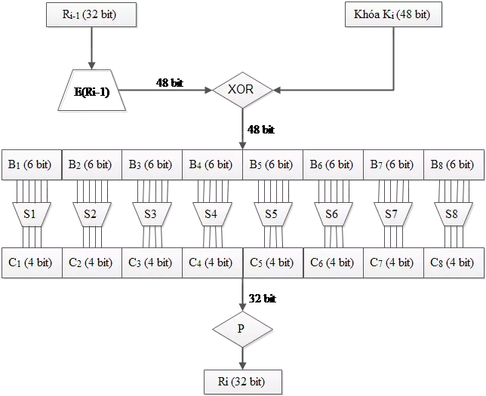
Key Ki (48 bit)

Slide 5
